Slide 1


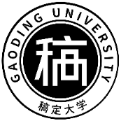


GRADUATION THESIS DEFENSE
毕业论文答辩
论中国菜名的不可译性
姓名：高小定 学号：20190529 学校：稿定大学 指导老师：稿定

Slide 2
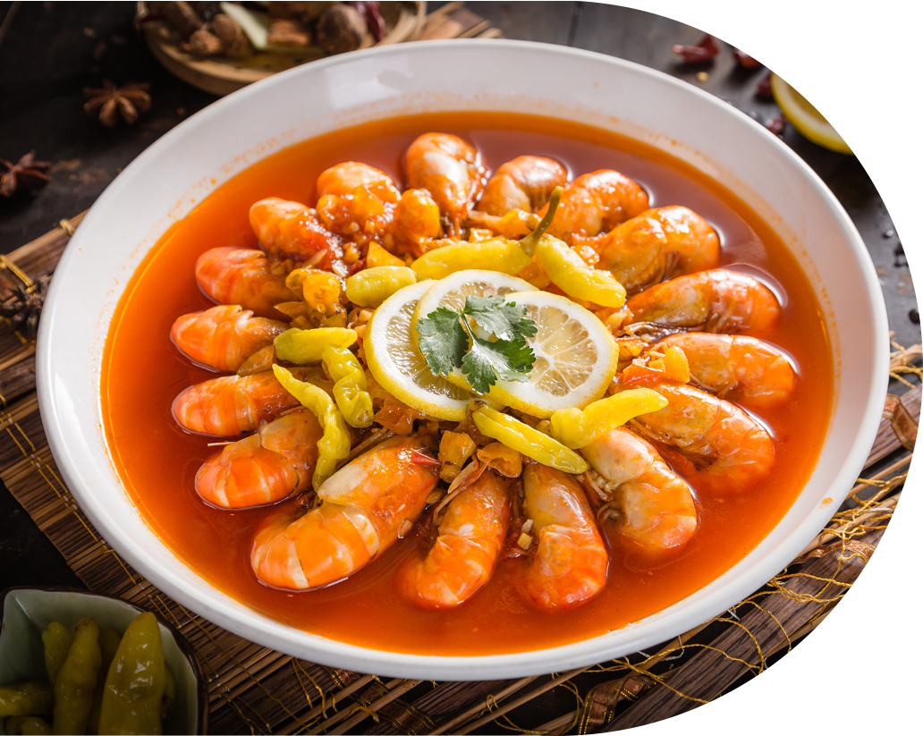
目录
CATALOGUE
绪论
总结和结论
1.
4.
The Introduction
Summary and conclusions
理论基础
参考文献
2.
5.
Theoretical Basis
Bibliography
内容展示
致谢
3.
6.
Content exposition
Acknowledgement

Slide 3
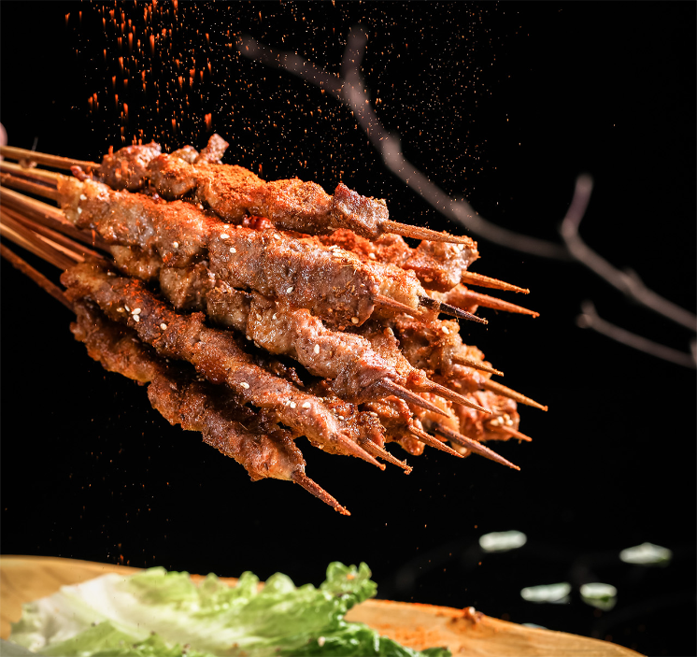
绪论
The Introduction
Based on the theories concerning untranslatability, this thesis at first illustrates the linguistic and cultural untranslatability between Chinese and English respectively. And it then emphasizes particularly on the cultural untranslatability on English translation of Chinese dish names. Finally, according to the classification of dish names, translation techniques are suggested and some of them are just the compensative measures to those untranslatable dish names.

Slide 4

02
PART
理论基础
THEORETICAL BASIS

Slide 5







理论基础
THEORETICAL BASIS
Vagueness
1
5
Relativity of the Principle of Isomorphs.
Peter Newmark’s Theory on Loss of Meaning.
2
4
Sapir-Whorf Hypothesis.
3
Linguistic Untranslatability and Cultural Untranslatability Put Forward by J. C. Catford.

Slide 6
03
PART
内容展示
CONTENT EXPOSITION

Slide 7







第一章
可译性与不可译性悖论
翻译在人类文明中起着重要作用。
Translation plays an important role in human civilization.
翻译是一个充满悖论的领域。
Translation is a field full of paradoxes.
关于不可译性问题的讨论。
Discussions on the problem of untranslatability.
可译性或不可译性是矛盾对立的辩证统一。
Translatability or untranslatability are a dialectical unity of contradictory opposites.

Slide 8

第二章
英汉差异造成的不可译性
英汉语言差异导致的不可译性
1.Unique Phonetic Features in Chinese and English.
2.Unique Word-Formation in Chinese and English.
3.Different Figure of Speech in Chinese and English.
英汉文化差异导致的不可译性
1.Differences of Thinking.
2.Different Beliefs and Values.
3.Different Customs and Living Environment .
4.Historical Influence.
5.Lexical Non-Equivalence Concerned with Cultural Difference.
6.Absence of Terms
7.Discrepancy of Semantic Association.

Slide 9





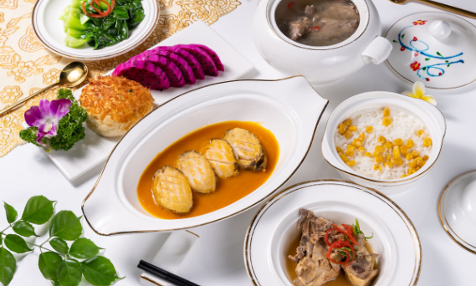
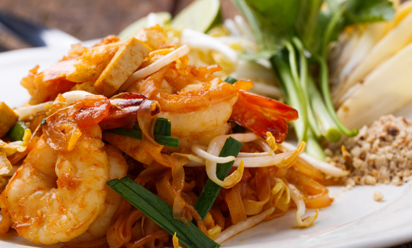
第三章
中国饮食文化与中国菜名分析
3.1
3.2
3.3
中国烹饪文化
目前中文菜名英译存在的问题
中国菜名
CHINESE CUISINE CULTURE
PROBLEMS IN THE EXISTINGENGLISH TRANSLATION OFCHINESE DISH NAMES
CHINESE DISH NAMES

Slide 10
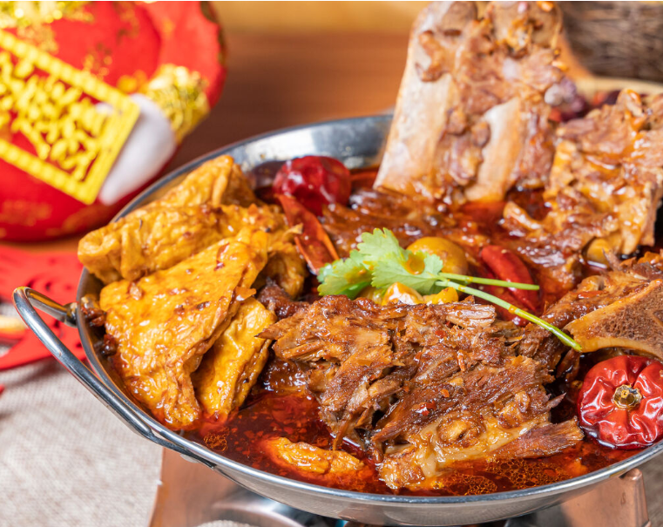
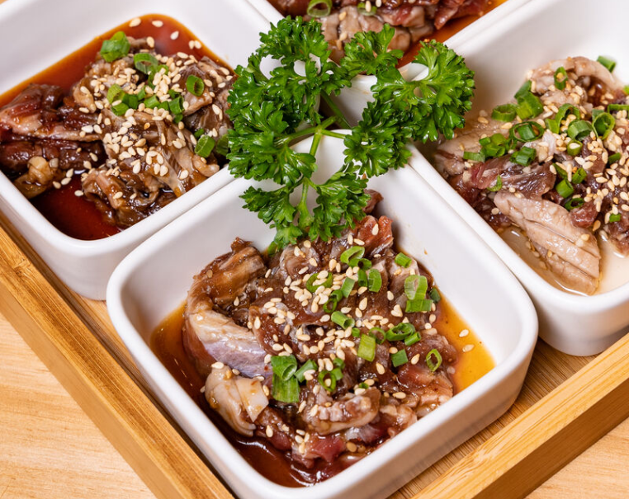
3.1
中国烹饪文化
CHINESE CUISINE CULTURE
八大区域菜系
中国菜特色

Slide 11















3.1
中国菜名
CHINESE DISH NAMES
中国菜名构成
信息功能
文化功能
01
03
05
02
04
中国菜名的作用
审美功能

Slide 12
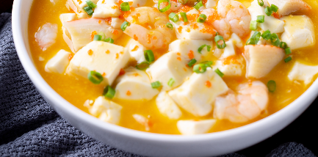

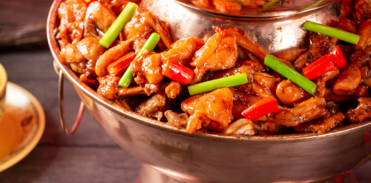
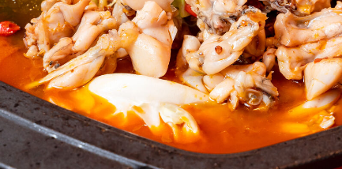
3.3
目前中文菜名英译存在的问题
PROBLEMS IN THE EXISTING ENGLISH TRANSLATION OF CHINESE DISH NAMES
Failure in Conveying the Original Meaning.
Multiple Translated Versions for One Dish Name.
Antipathy Due to the Images in the English Version.

Slide 13
第四章
中文菜名英译不可译性
CAUSED BY DIFFERENCES OF THINKING
CAUSED BY DIFFERENT BELIEFS AND VALUES
CAUSED BY DIFFERENT CUSTOMS
CAUSED BY HISTORICAL INFLUENCE
CAUSED BY LEXICAL NON-EQUIVALENCE

Slide 14







第五章
中国菜名分类
SELF-DESCRIPTIVE
NAMES
NAMES AFTER
A PERSON
NAMES AFTER
A PLACE
NAMES WITH
METAPHOR
NAMES WITH
LEGEND OR ALLUSION
PROPITIOUS
NAMES

Slide 15




第六章
中文菜名翻译建议方法
Literal Translation.
Literal Translation with Explanation.
Free Translation with Literal Translation or Explanation.
Free Translation or Literal Translation with Brief Background Explanation.

Slide 16
04
PART
总结和结论
SUMMARY AND CONCLUSIONS

Slide 17
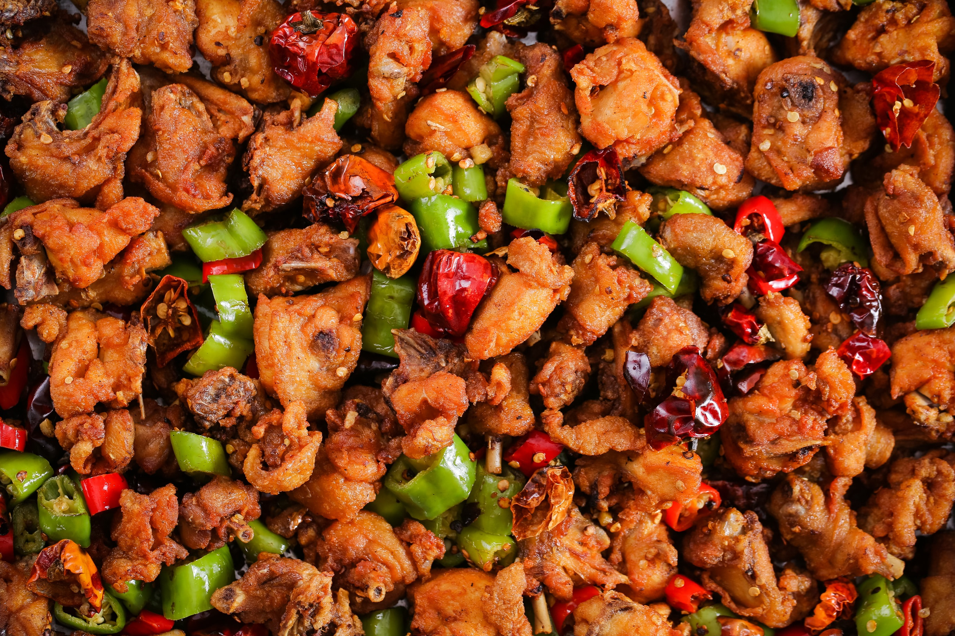


SUMMARY
AND CONCLUSIONS
It should be mentioned that some ideas put forward in the present paper might be immature due to the author’s limited knowledge about cuisine and the lack of translation experience. This tentative study on untranslatabiltiy of Chinese dish names is greatly motivated by her interest in its practical value.
The author hopes that more excellent English versions of Chinese dish names will be produced and Chinese cuisine culture will be spread further. Therefore,suggestions and criticisms are always welcome.

Slide 18
05
PART
参考文献
THE BIBLIOGRAPHY

Slide 19

5.1
英文参考文献
ENGLISH REFERENCES
1.Claire Kramsch, Language and Culture [M]. Shanghai Foreign Language Education Press, 2000.
2.Eugene A. Nida, Language and Culture-Context in Translating [M].Shanghai Foreign Language Education Press, 2001.
3.J. C. Catford, A Linguistic Theory of Translation [M]. Oxford University Press, 1965.
4.Jin Di, Eugene A. Nida, On Translation-with special reference to Chinese and English[M]. 中国对外翻译出版公司，1984.
5.Peter Fawcett, Translation and Language---Linguistic Theories Explained.
6.Peter Newmark, A Textbook of Translation [M]. London: Prentice Hall International (UK) Ltd, 1988.
7.Peter Newmark, About Translation [M]. Foreign Language Teaching and Research Press, 2006.
8.Peter Newmark, Approaches to Translation [M]. Shanghai Foreign Language Education Press, 2001.
9.Ronald Wardhaugh, An Introduction to Sociolinguistics [M]. Foreign Language Teaching and Research Press, 2000.
10.Sapir, Edward, The Art of Suggestion [M]. Foreign Language Teaching and Research Press, 1997.

Slide 20

5.2
中文参考文献
CHINESE REFERENCES
11. 陈定安编著，英汉修辞与翻译 [M]. 中国青年出版社，2004.
12. 陈林华， 语言学导论 [M]. 吉林大学出版社，1999.
13. 龚光明, 翻译思维学 [M]. 上海社会科学院出版社, 2004.
14．胡文仲，超越文化的屏障 [M]. 外语教学与研究出版社，2004. 67
15. 胡兆量，阿尔斯朗，琼达等编著，中国文化地理概述 [M]. 北京大学 出版社，2001.
16. 胡壮麟， 语言学教程 [M]. 北京大学出版社，2001.
17. 金惠康， 跨文化交际翻译续编 [M]. 中国对外翻译出版公司，2004.
18. 刘凤玲， 菜肴命名艺术与饮食文化 [J]. 广州大学学报（社会科学版） 2005(2).
19. 刘宓庆，新编当代翻译理论 [M]. 中国对外翻译出版公司，2005.
20. 刘清波， 中式菜名英译的技巧和原则 [J]. 中国科技翻译, 2003，(4).

Slide 21
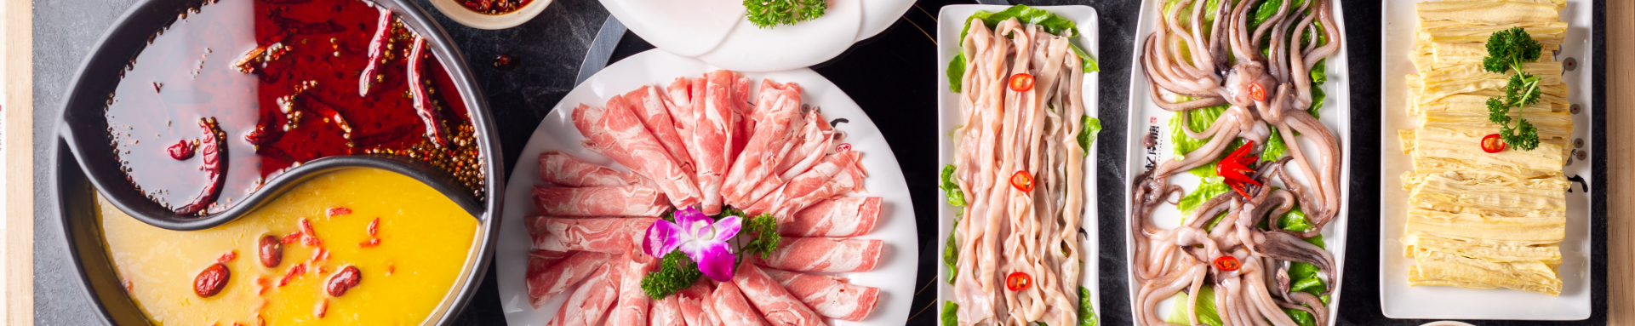

ACKNOWLEDGEMENT
感谢所有老师以及那些直接和间接支持我完成这项工作的人的帮助、鼓励和支持。

Slide 22

THANK YOU FOR LISTENING!
谢谢你的聆听

